Slide 1

Filter Bubbles in Opinion Formation
Agent-Based Modeling and Social System Simulation

Slide 2
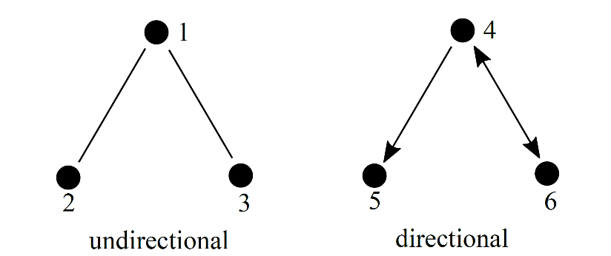
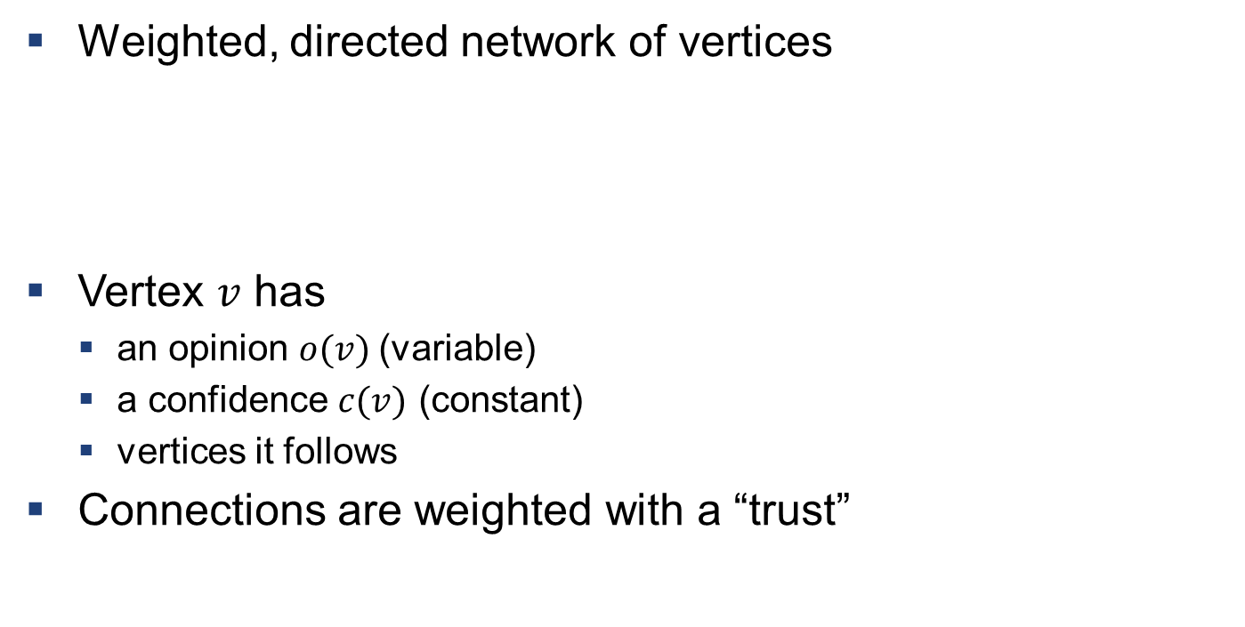
Description of the Model
Weighted, directed network of vertices
Vertex $v$ has
an opinion $o(v)$(variable)
a confidence $c(v)$ (constant)
vertices it follows
Connections are weighted with a “trust”

Slide 3
Following and Unfollowing
Vertex can “follow” and “unfollow” vertices
Stochastic model
probability to follow dependent on opinion difference
probability to unfollow dependent on the trust of the connection
Allows for the implementation of filter bubbles

Slide 4
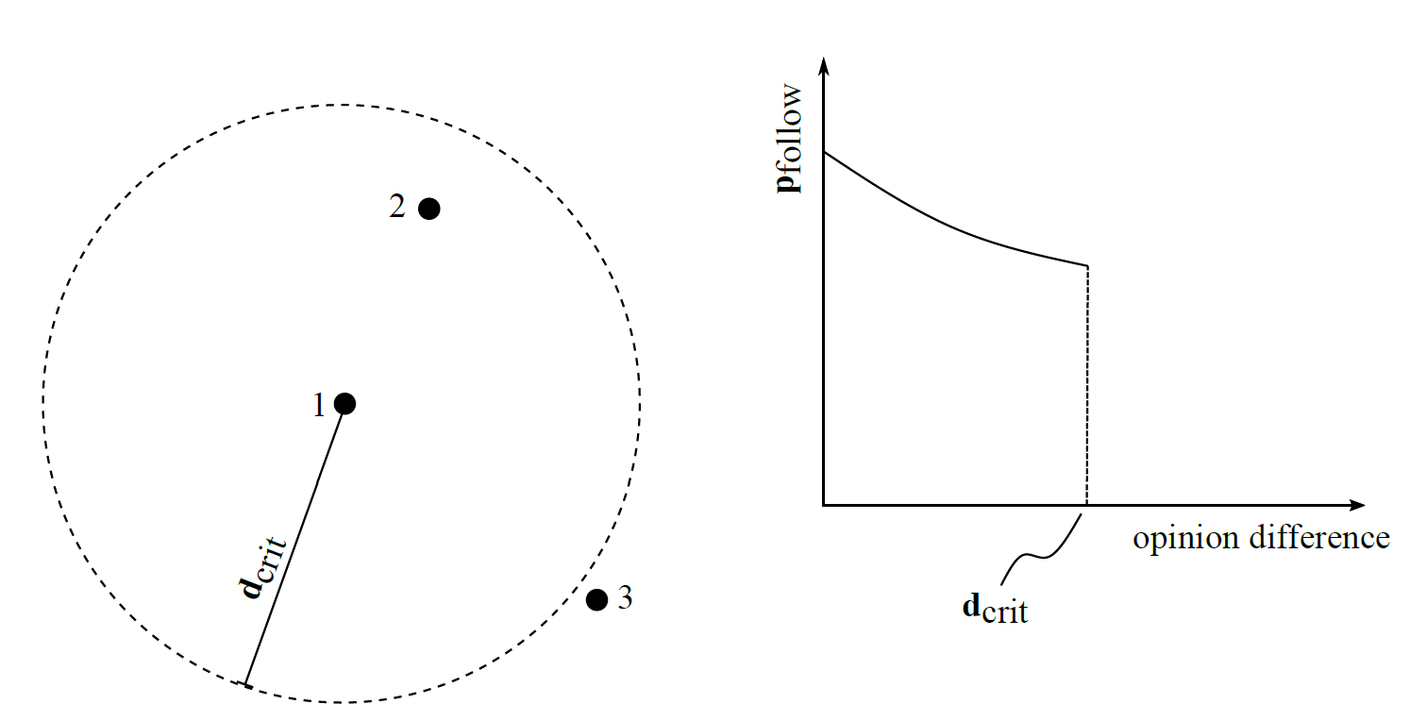

Slide 5
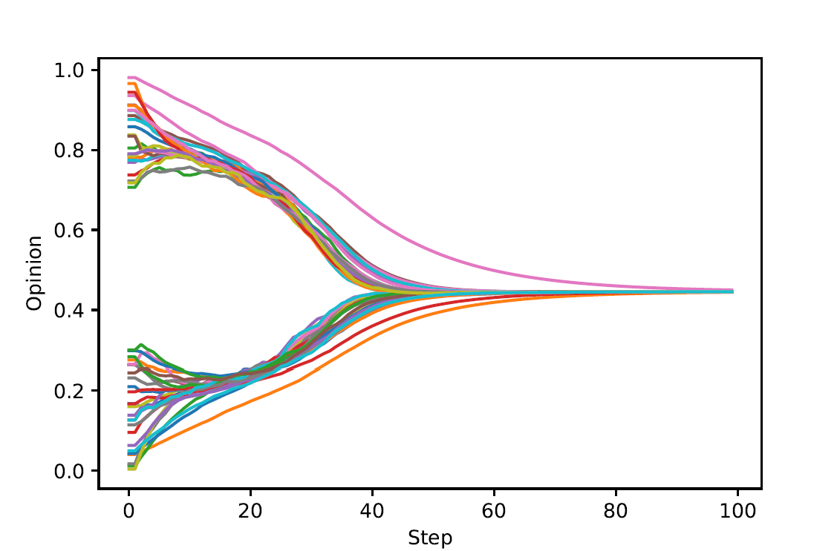
Merging of Opinion Strands
Initialise opinions with a separation → two initial bubbles
When do the strands merge?

Slide 6
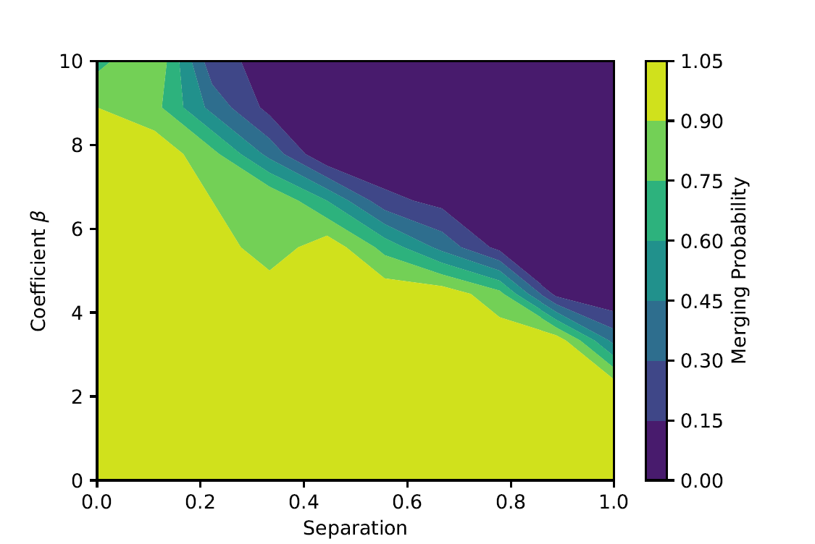

Slide 7
